Slide 1
C Structure

Slide 2
In C programming, a struct (or structure) is a collection of variables (can be of different types) under a single name.
To define a struct, the struct keyword is used.
Syntax of structure
struct structureName {
dataType member1;
dataType member2;
...
};
For example,
struct Person {
char name[50];
int citNo;
float salary;
};
Here, a derived type struct Person is defined. Now, you can create variables of this type.

Slide 3
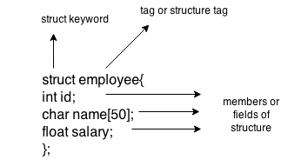
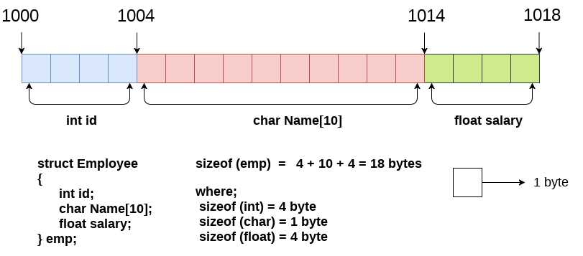
struct employee
{ int id;
char name[20];
float salary;
};

Slide 4
Create struct Variables
When a struct type is declared, no storage or memory is allocated. To allocate memory of a given structure type and work with it, we need to create variables.
Here's how we create structure variables:
struct Person {
// code
};
int main() {
struct Person person1, person2, p[20];
return 0;
}

Slide 5
Another way of creating a struct variable is:
struct Person {
// code
} person1, person2, p[20];
In both cases,
person1 and person2 are struct Person variables
p[] is a struct Person array of size 20.

Slide 6
Access Members of a Structure
There are two types of operators used for accessing members of a structure.
. - Member operator
-> - Structure pointer operator
Suppose, you want to access the salary of person2. Here's how you can do it.
person2.salary

Slide 7
Example 1: C structs
#include <stdio.h>
#include <string.h>
// create struct with person1 variable
struct Person {
char name[50];
int citNo;
float salary;
} person1;
int main() {
// assign value to name of person1
strcpy(person1.name, "George Orwell");
// assign values to other person1 variables
person1.citNo = 1984;
person1. salary = 2500;
// print struct variables
printf("Name: %s\n", person1.name);
printf("Citizenship No.: %d\n", person1.citNo);
printf("Salary: %.2f", person1.salary);
return 0;
}
Output
Name: George Orwell
Citizenship No.: 1984
Salary: 2500.00

Slide 8
#include <stdio.h>
struct student {
char firstName[50];
int roll;
float marks;
}
int main() {
Student s[5];
int i;
printf("Enter information of students:\n");
// storing information
for (i = 0; i < 5; ++i) {
s[i].roll = i + 1;
printf("\nFor roll number%d,\n", s[i].roll);
printf("Enter first name: ");
scanf("%s", s[i].firstName);
printf("Enter marks: ");
scanf("%f", &s[i].marks);
}
printf("Displaying Information:\n\n");
// displaying information
for (i = 0; i < 5; ++i) {
printf("\nRoll number: %d\n", i + 1);
printf("First name: ");
puts(s[i].firstName);
printf("Marks: %.1f", s[i].marks);
printf("\n");
}
return 0;
}

Slide 9
Define structure Student having data members: Roll no, name, address, branch and percentage. WAP to read and display information of a student.
Define structure called cricket that will describe the following data Player name, country name, no of matches played & batting avg. Develop a program that store information of 10 players and display names of players having batting average greater than 50.
There are 50 computers in an office. Every computer has following information CPU type, hard disk size. WAP to store details of all 50 computers and then print details of computers having hard disk size greater than 8 GB.

Slide 10
Write a program to store and print the roll no., name , age and marks of a student using structures.
2.Write a program to store the roll no. (starting from 1), name and age of 5 students and then print the details of the student with roll no. 2.
3.Write a program to store and print the roll no., name, age, address and marks of 15 students using structure.
Enter the marks of 5 students in Chemistry, Mathematics and Physics (each out of 100) using a structure named Marks having elements roll no., name, ch
Write C program to read the details of two workers and calculate total payment of workers using structure. Name,wage rate, days

Slide 11
Write C program to accept the details of employee and display them using structure. Details consist of Employee ID, Name, Designation, Department, Salary.

Slide 12
int main()
{
struct employee a;
printf("Enter Employee Details:\n");
printf("-------------------------------\n");
printf("Enter Employee-Id : ");
scanf("%d",&a.e);
printf("Enter Name : ");
scanf("%s",a.name);
printf("Enter Designation : ");
scanf("%s",a.designation);
printf("Enter Department : ");
scanf("%s",a.dept);
printf("Enter Salary : ");
scanf("%d",&a.sal);
printf("-------------------------------");
printf("\nEmployee Details: \n---------------------------------\n");
printf("Employee-Id : %d\n",a.e);
printf("Name : %s\n",a.name);
printf("Designation : %s\n",a.designation);
printf("Department : %s\n",a.dept);
printf("Salary : %d\n",a.sal);
return 0;
}
#include<stdio.h>
struct employee
{
int e;
char name[20];
char designation[20];
char dept[20];
int sal;
};

Slide 13
Write C program to accept batting information of cricket team using structure. It contains player name and runs scored by player. Calculate total runs scored by cricket team.

Slide 14
#include<stdio.h>
struct player
{
char name[20];
int runs;
};
int main()
{
int i,s=0;
struct player a[11]; //a[11] - no. of players
printf("Enter Name of Player Runs Scored \n");
printf("---------------------------------------------\n\t");
for(i=0;i<=10;i++)
{
scanf("%s",a[i].name);
scanf("%d",&a[i].runs);
printf("\t");
}
for(i=0;i<=10;i++)
s=s+a[i].runs;
printf("\n---------------------------------------------\n");
printf("Total Runs Scored by Team: %d",s);
return 0;
}

Slide 15
Write a 'C' program to accept customer details such as: Account_no, Name, Balance using structure. Assume 3 customers in the bank. Write a function to print the account no. and name of each customer whose balance < 100 Rs.

